Slide 1
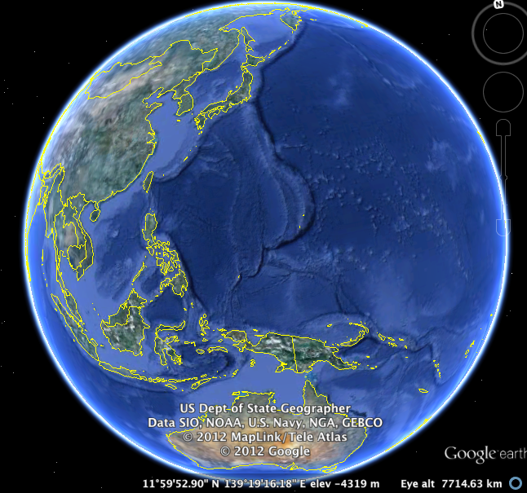
In-Class Assignment:
Create a pictorial timeline of the
Battle of the Pacific!
Directions: Working in groups of 2-3, you will create a massive timeline of the Battle of the Pacific. Your timeline must:
1) Include animated depiction of the battle
2) Include: Pearl Harbor, Midway, Coral sea / Guadalcanal, Leyte Gulf/Phillipines, Iwo Jima/Okinawa, and lastly Hiroshima/ Nagasaki
3) Each major event/battle must be hyperlinked to a different slide which describes that event, including an illustration and description of the battle.
(What happened? Who won, dates, tactics, etc)

Slide 2
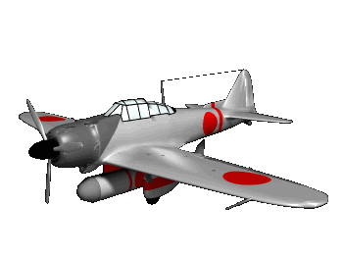
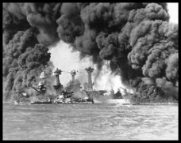
December 7, 1941—Pearl Harbor bombed by the Japanese.
1941

